Slide 1

Effective Heart Disease Prediction Using Hybrid Machine Learning Techniques
15CS86
TECHNICAL SEMINAR
Date : 26/01/2020
Name : Chandan S J
USN : 1CR16CS040
Under the guidance of:
Mrs. RUBINI P E,
Assistant Professor
Department of Computer Science & Engineering

Slide 2
Abstract
Heart disease is one of the most significant causes of mortality in the world today
Machine learning is helping the healthcare industries to make decisions on huge datasets.
Even IOT’s are used with machine learning,
HRFLM(Hybrid Random Forest with a linear model): Prediction of Cardio vascular disease,
Accuracy level :88.7 percent

Slide 3
Outline
INTRODUCTION
LITERATURE SURVEY
METHODOLOGIES USED
RESULTS AND DISCUSSION
Critical Review
CONCLUSION
REFERENCES

Slide 4
INTRODUCTION
It is difficult to identify heart disease because of several contributory risk factors such as diabetes, high blood pressure, high cholesterol, abnormal pulse rate and many other factors.
Various techniques in data mining and neural networks have been employed to find out the severity of heart disease among humans
The nature of heart disease is complex and hence, the disease must be handled carefully
The main objective of this research is to improve the performance accuracy of heart disease prediction.
In contrast, the HRFLM method uses all features without any restrictions of feature selection.

Slide 5
INTRODUCTION
Here we conduct experiments used to identify the features of a machine learning algorithm with a hybrid method.
The experiment results show that our proposed hybrid method has stronger capability to predict heart disease compared to existing methods.

Slide 6
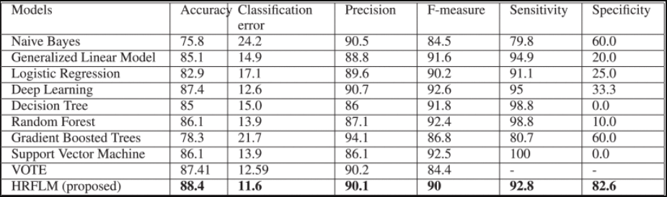
LITERATURE SURVEY
HRFLM is a best approach for prediction of Cardio vascular diseases till now as it has no restriction of using all features without any restrictions of feature selection.
Decision Trees ,Language Model , Support Vector Machine , Random Forest ,Naive Bayes ,Neural Networks , K-Nearest Neighbors used in other papers have lesser chances of prediction than this approach.

Slide 7
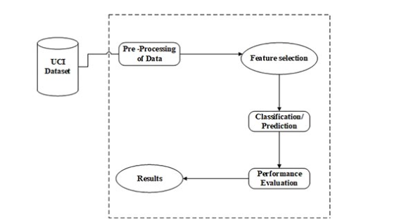
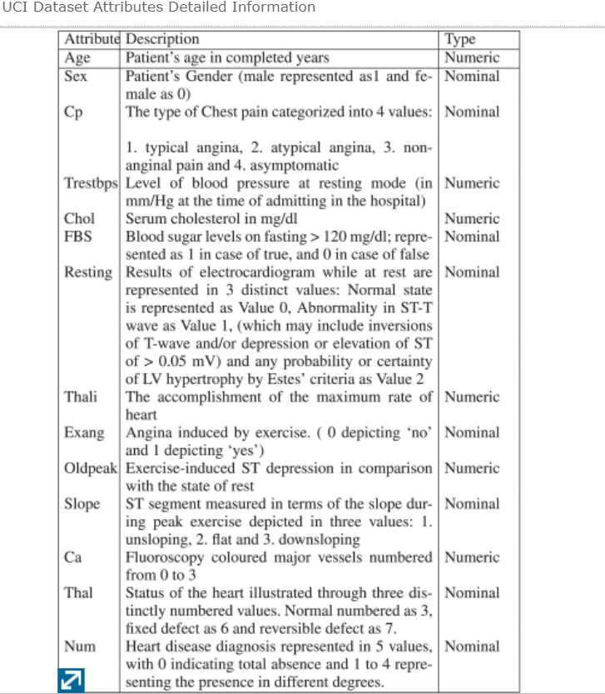
METHODOLOGIES

Slide 8
METHODOLOGIES
Data Pre-Processing:
Cleaning of the dataset is done
Extract , transform and load operation
The multi-class variable is used to check the presence or absence of heart disease
The pre-processing of data is carried out by converting medical records into diagnosis values

Slide 9
METHODOLOGIES
Feature Selection and Reduction
Clinical records :other than sex and age
Clinical records are vital to diagnosis and learning the severity of heart disease.
As previously mentioned in this experiment, several (ML) techniques are used namely, NB, GLM, LR, DL, DT, RF, GBT and SVM.
The experiment was repeated with all the ML techniques using all 13 attributes.

Slide 10
METHODOLOGIES
Classification Modelling: [Clustering and classification]
Decision Trees : For training samples of data D , the trees are constructed based on high entropy inputs.
Language Model: The linear form of solution f(x)= mx+b is solved by subsequent parameters
Support Vector Machine: This will find the optimal hyperplane,
Random Forest : This ensemble classifier builds several decision trees and incorporates them to get the best result.
Naive Bayes : This learning model applies Bayes rules through independent features. Every instance of data D is allotted to the class of highest subsequent probability.
Neural Networks: The final result is produced through the activation function like sigmoid and a bias constant b .
K-Nearest Neighbors : It extract the knowledge based on the samples Euclidean distance function d(xi,xj) and the majority of k-nearest neighbors

Slide 11
METHODOLOGIES
Performance Measures:
Several standard performance metrics such as accuracy, precision and error in classification have been considered for the computation of performance efficacy of this model.
Precision is defined as the percentage of corrective prediction in the positive class of the instances.
To identify the significant features of heart disease, three performance metrics are used which will help in better understanding the behavior of the various combinations of the feature-selection.
The performance of every classifier is evaluated individually and all results are adequately recorded for further investigation.

Slide 12
METHODOLOGIES
HRFLM Algorithms:
Algorithm 1 Decision Tree-Based Partition
Input: D dataset – features with a target class
for ∀ features do
for Each sample do
Execute the Decision Tree algorithm
end for
Identify the feature space f1 , f2 , … , fx of dataset UCI. (9)
end for
Obtain the total number of leaf nodes l1 , l2 , l3 , … , ln with its constraints (10)
Split the dataset D into d1 , d2 , d3 , … , dn based on the leaf nodes constraints. (11)
Partition datasets d1 , d2 , d3 , … , dn
Algorithm 2 Apply ML to Find Less Error Rate
Input: Datasets with partition – d1 , d2 , d3 , … , dn
for ∀ apply the rules do
On the dataset R(d1,d2,d3, … … dn)
end for
Classify the dataset based on the rules C(R(d1 ),R(d2 ) … …R (dn )) (12)
Classified datasets with rules C(R(d1 ),R(d2 ) … …R (dn ))

Slide 13
METHODOLOGIES
Algorithm 3 Feature Extraction Using Less Error Classifier
Input: Classified datasets C(R(d1 ),R(d2 ) … …R (dn ))
for ∀ Find out min error rate from the input do
Min(C(R(d1 ),R(d2 ) … …R (dn ))) (13)
end for
Find out max(min) error rate from the classifier.
Features with classified attributes F(d1 , d2 , d3 , … , dn)
Algorithm 4 Apply Classifier on Extracted Features
Apply the hybrid method based on the error rate
∑n0F(n)=∑n0F(0)=d+m1x1+m2x2+....+mnxnGain+∑n0wixi(14)(15)

Slide 14
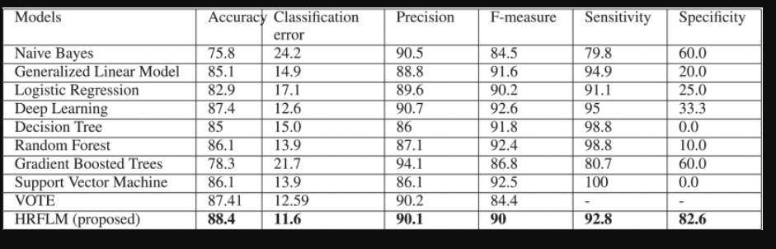
RESULTS AND DISCUSSION
The prediction models are developed using 13 features and the accuracy is calculated for modeling techniques.
The best classification methods are given below.

Slide 15
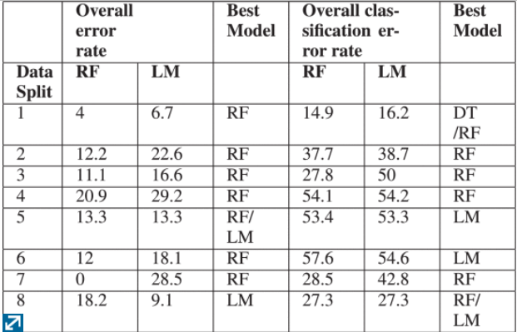
CRITICAL REVIEW

Slide 16
Conclusion
Identifying the processing of raw healthcare data will help in the early detection of abnormalities in heart conditions.
the mortality rate can be drastically controlled if the disease is detected at the early stages and preventative measures are adopted as soon as possible.
feature-selection methods can be developed to get a broader perception of the significant features to increase the performance of heart disease prediction.

Slide 17
References
Websites:
IEEE : https://ieeexplore.ieee.org/popular/all
https://www.healthcatalyst.com/clinical-applications-of-machine-learning-in-healthcare
https://link.springer.com/chapter/10.1007/978-3-642-30217-6_13
analyticsvidhya.com/blog/2017/09/common-machine-learning-algorithms/

Slide 18
THANK YOU

